Slide 1
MLscan
Machine Learning Mailing List Scanner
Greg Padgett
March 29, 2016

Slide 2
Motivation
A lot of traffic on the ovirt-users list.
A lot of emails for the qe contact to scan.
What if we could flag these messages automatically?
Even send an email to the current qe contact?
Create a program that can scan email and identify these messages based on some properties of the message.
What properties?

Slide 3
Some Ideas...
Don’t worry about mails sent from @redhat.com addresses.
Only look at the root message in email threads.
Does “storage” appear in the mail?
Some data:
[~]$ wc -l /tmp/mlscan.Interesting 188 /tmp/mlscan.Interesting [~]$ grep -ic storage /tmp/mlscan.Interesting 104 [~]$ wc -l /tmp/mlscan.NotInteresting 188 /tmp/mlscan.NotInteresting [~]$ grep -ic storage /tmp/mlscan.NotInteresting 48
“Storage” appears in 55% of messages we replied to, and 25% of the messages we didn’t reply to.
Maybe we don’t know what features to look for after all?

Slide 4
Machine Learning
What if we could have the program figure out what helps identify the interesting emails by itself?
Sounds like Machine Learning
Machine Learning:
"Field of study that gives computers the ability to learn without being explicitly programmed" - Arthur Samuel, 1959
“[...] explores the study and construction of algorithms that can learn from and make predictions on data.” - wikipedia
Glorified statistics

Slide 5
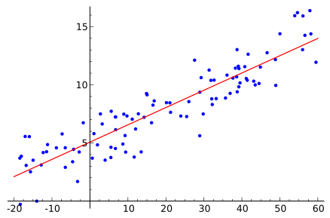
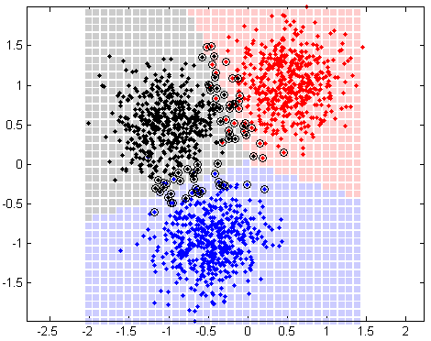
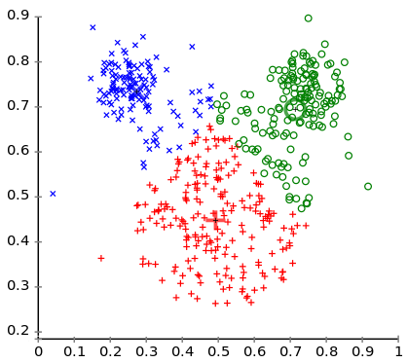
Machine Learning: More Detail
Learning
Supervised - give the algorithm the right answer
Unsupervised - learns the answer itself
Reinforcement - on-line exploration of environment to maximize reward
Categories:
Regression
- Continuous-valued data.
Linear Regression
Polynomial, etc.
Classification
- Divide into known groups.
Naive Bayes
Support Vector Machines
Neural Networks
Clustering
- Divide into unknown groups.
k-means

Slide 6
Naive Bayes
Family of supervised classification algorithms:
Bernoulli - binary occurrence of features
Multinomial - counts occurrence of features
Gaussian - continuous data
Often used for spam filtering
What’s naive about it?
Assumes feature probabilities are independent.
Not always true (e.g. language processing) but works well anyway…
Relatively simple
Basically, the classification is chosen based on the probability of the input’s features occurring in that class: highest wins.

Slide 7
The Heuristic
“Interesting Senders” Heuristic:
Consider a thread interesting if one of us (storage) replied in the thread.
Don’t ever consider an email from @redhat.com interesting
Replies within a thread aren’t interesting, only the first message.
We can always monitor a thread that’s already interesting.

Slide 8
The Program
Parse mailing list archives
Text mbox format; “\nFrom” delineates records
Parse messages
Apache mime4j
Collate email threads
Simple tree structure, using Message-Id, In-Reply-To headers
Label training examples
“Interesting Senders” heuristic
Train the classifier
Naive Bayes using Datumbox Machine Learning Framework (Java)
Classify new inputs
Not yet on-line

Slide 9
Features
Chosen by the classifier based on the input
Email subject and body text
Chi Square - keep most statistically significant features
N-grams
Word sequences
In our case, actually uni-grams (possibly due to small training set size)
Tri-grams also work pretty well (and are commonly used)
Garbage In, Garbage Out
Remove “stop words”, too.
public static String getClassificationDataFromMail(EmailThreadItem message) {
return removeStopWords(removeSingleCharWords(removePunctuation(
message.getEmail().getSubject().toLowerCase()
+ " "
+ removeLogs(removeAttachmentText(
message.getEmail().getBody().toLowerCase())))));
}

Slide 10
private TextClassifier getClassifier(Map<String, File> trainingSetFiles) {
RandomGenerator.setGlobalSeed(randomSeed);
Configuration conf = Configuration.getConfiguration();
Map<Object, URI> dataset = new HashMap<>();
for (String classification : trainingSetFiles.keySet()) {
dataset.put(classification, trainingSetFiles.get(classification).toURI());
}
TextClassifier.TrainingParameters trainingParameters = new TextClassifier.TrainingParameters();
trainingParameters.setModelerClass(MultinomialNaiveBayes.class);
trainingParameters.setModelerTrainingParameters(new MultinomialNaiveBayes.TrainingParameters());
trainingParameters.setDataTransformerClass(null);
trainingParameters.setDataTransformerTrainingParameters(null);
trainingParameters.setFeatureSelectorClass(ChisquareSelect.class);
ChisquareSelect.TrainingParameters chisquareParameters = new ChisquareSelect.TrainingParameters();
chisquareParameters.setALevel(0.10); // p-ratio; the default, made explicit
trainingParameters.setFeatureSelectorTrainingParameters(chisquareParameters);
trainingParameters.setTextExtractorClass(NgramsExtractor.class);
NgramsExtractor.Parameters ngramParameters = new NgramsExtractor.Parameters();
ngramParameters.setMaxCombinations(1); // The default, made explicit
trainingParameters.setTextExtractorParameters(ngramParameters);
TextClassifier classifier = new TextClassifier("InterestingSendersClassifier", conf);
classifier.fit(dataset, trainingParameters);
ValidationMetrics vm = classifier.validate(dataset);
classifier.setValidationMetrics(vm); //store them in the model for future reference
return classifier;
}

Slide 11
Demo

Slide 12
Results
Test run:
92 messages total, 62 predicted successfully (67.39%)
72 uninteresting messages, 44 predicted successfully (61.11%)
20 interesting messages, 18 predicted successfully (90.00%)
Takeaway:
We can skip 46 of 92 threads (50%) and still find 90% of the “interesting” messages.
Should get even better with more training data.

